Slide 1

Northern University Bangladesh
Log Based Endpoint Security Solution
Present by
Md. Asgor Ali (21190101016)
Md. Abdul Kader (21190301213)
Abdullah Al Mamun (2119010144)
Sajib Chandra Adhikari (21190301198)
Supervised by
Sumaiya Akter
Lecturer
Department Of CSE
Northern University Bangladesh

Slide 2

Agenda
Introduction
How did we get this idea?
What tools are used for this system?
Demonstration
Contribution
Capabilities of our project.
Feature development
Limitation
Conclusion
Reference

Slide 3




Introduction
What is Log based Endpoint Security System?
It’s an integrated security solution that capable to collecting and monitoring real-time log data from registered agent and provide automated response different type of security event.
Where it can use this system?
Domain Hosting Company
Corporate Office
Bank
Govt Office

Slide 4

Introduction
What is log ?
Why this system called Log base ?
A log file is a computer-generated data file that contains information about usage patterns, activities, and operations within an operating system
Basically it's taking the decision according to the system log file that's why it's called log based Endpoint security solution
Why do we need this ?
Intrusion Detection
Malware Detection
File Integrity monitoring
Segregated global Black listed IP
Vulnerability Detection
System Inventory Check

Slide 5

Motivation
Motivation

Slide 6

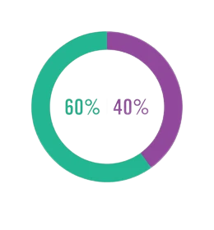
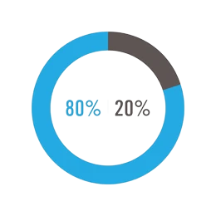
Motivation
According to the Cost of Insecure Endpoint research all over the world.
Only 40% of organization they can mitigate there endpoint vulnerabilities properly
$6 Million
80% of organization the don’t have any Endpoint strategy detect EndPoint devices Vulnerabilities
Annual cost to mitigate the endpoint vulnerability

Slide 7

Problem Statement
Many companies can't afford the solutions due to budget issue.
Cloud based solution.
Spying & Provides privacy issue.
Complex endpoint authentication.
Imposed upgrades.
Monopolies Issue.

Slide 8
Project Objective
01
02
03
04
Objective
Objective
Objective
Objective
Deploy a Log based Endpoint Security Solution with some Open Source tools.
Such as Elasticsearch Kibana Filebeat and Wazuh Engine
Integrate with the third-party Security Intelligence. Such as VirusTotal Alienvault CVE database etc. And collecting there feed properly and threat mitigation
Mitigate different types of cyber attacks.malware attacks, shellshock and attacks by collecting event data, and logs, detecting vulnerabilities, file integrity etc.
All the deployments we have done with minimal cost rather than an enterprise solution. That would be budget friendly for small or medium corporate environment.

Slide 9
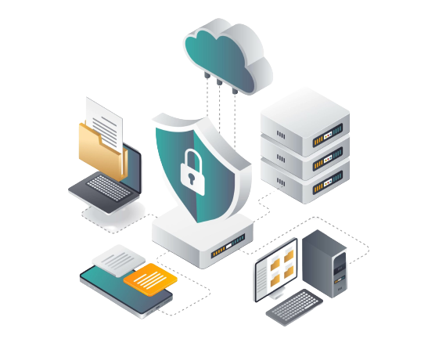




Main Function of the system
Log based Endpoint Security System, Perform the operation with this four major function.
Functions:
Collecting Log data
Analysis Log data
Identify Threat
Inform Admin

Slide 10
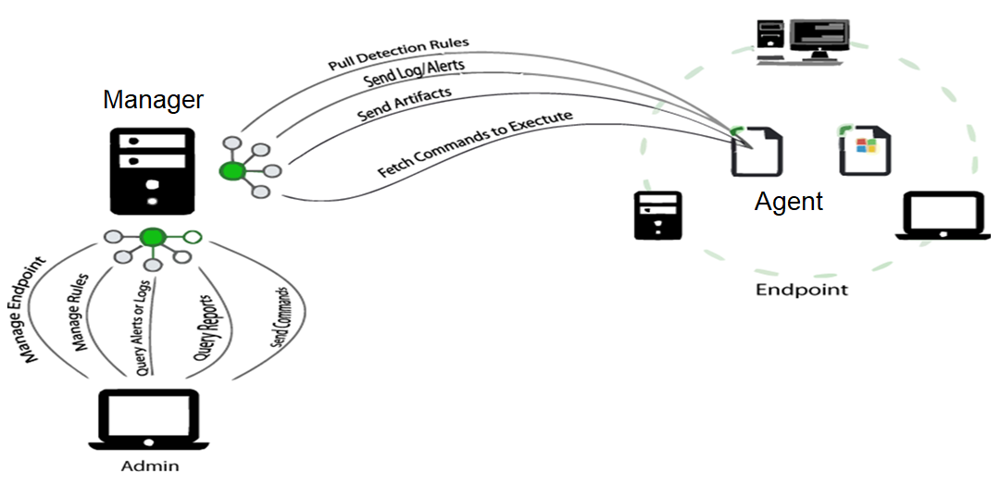
Endpoint Security System Architecture

Slide 11











Tools used for this system
Log.txt
Sent To
Wazuh Agent
Wazuh Manager
Intrusion detected
File modified
Vulnerability Detection
Malware Detection
Wazuh Manager
EBK

Slide 12
Tools used for this system
Filebeat
Elasticsearch
Kibana
Filebeat is a lightweight shipper for forwarding and centralizing log data. Installed as an agent on your servers, Filebeat monitors the log files or locations that you specify, collects log events, and forwards them either to Elasticsearch
Elasticsearch is a distributed, open-source search and analytics engine.It’s allows you to store, search, and analyze huge volumes of data quickly and in near real-time and give back answers in milliseconds. Also it’s perform operation on text base data and working like NoSQL database.
Kibana is an open source browser based visualization tool mainly used to analyse large volume of logs in the form of line graph, bar graph, pie charts, coordinate maps, gauge, goals, timelion etc. The visualization makes it easy to predict or to see the changes respect to time.

Slide 13
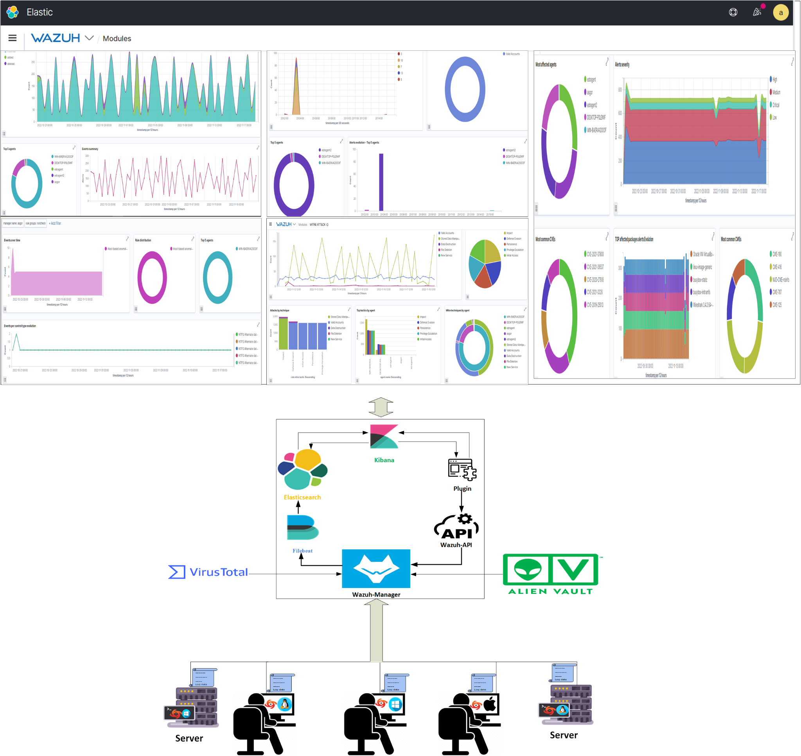
Project Diagram

Slide 14
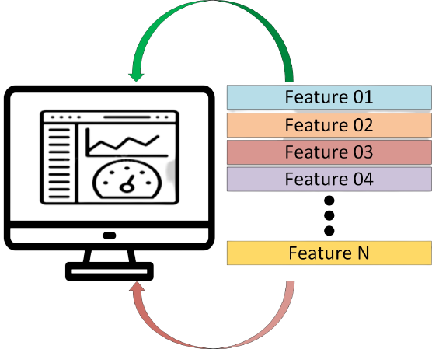
Demonstration

Slide 15

Contribution
Collecting all required tools and setup the environment to install all the tools and properly configure that to data share each other.
We have collected the different level log from the operating system.
We have Configure to integrate the vulnerability database and collect the feed for vulnerable applications.
This system we are instigated with Virustotal Security Intelligent and detecting malware.
We have collected globally backlisted IP addresses from alien-vault to detect connections from globally blacklisted IP addresses.
Configure file integrity monitoring to detect file tempering.

Slide 16
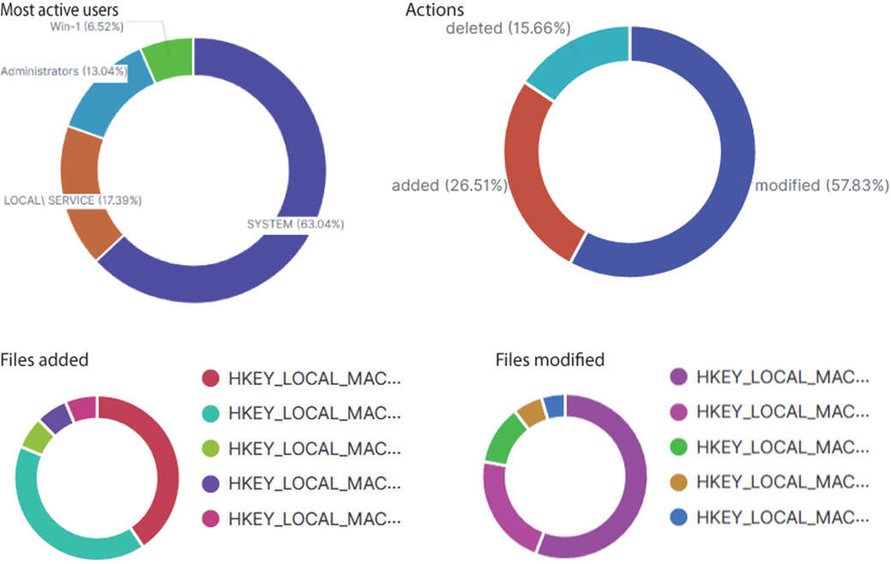
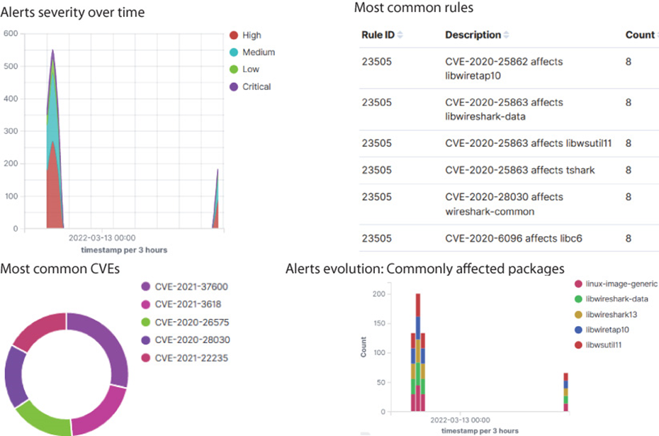
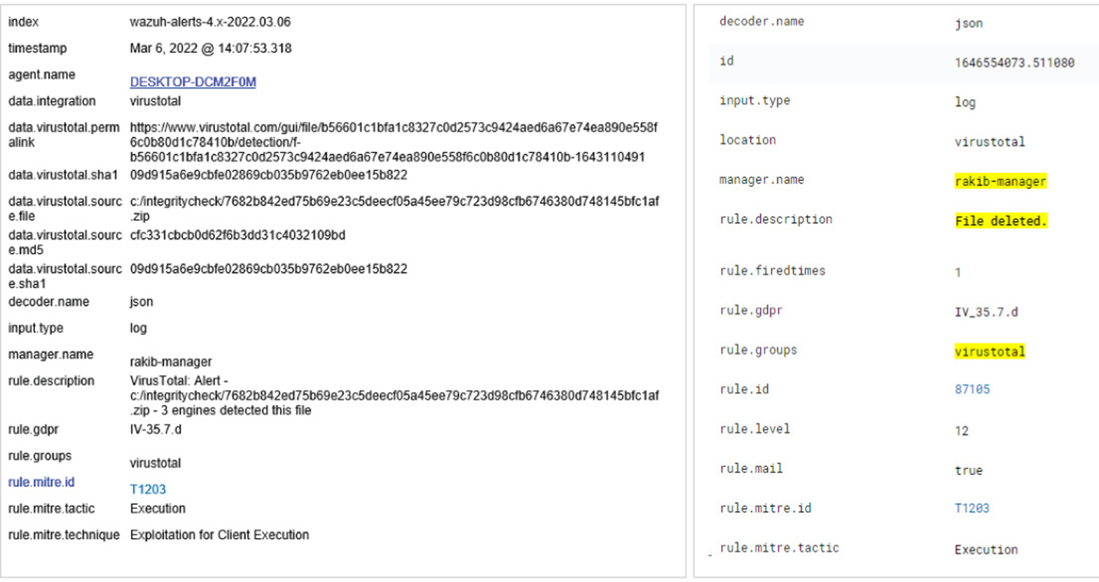
Capabilities
Malware Hash Value
CVE ID
for Vulnarivites
File integrity temparing alert
File Integrity Monitoring
Vulnerability Scanning
Malware Detection Capabilities

Slide 17
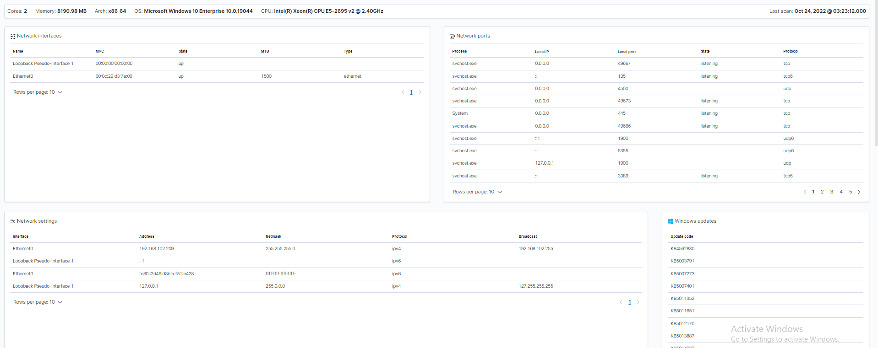
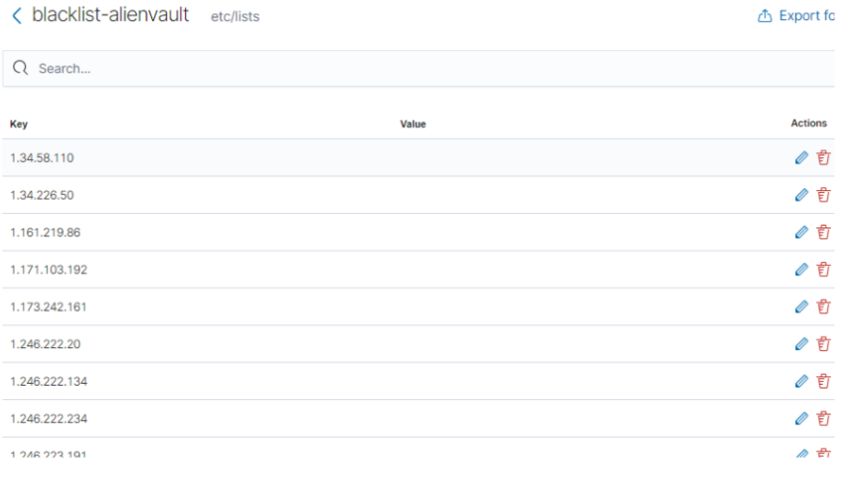
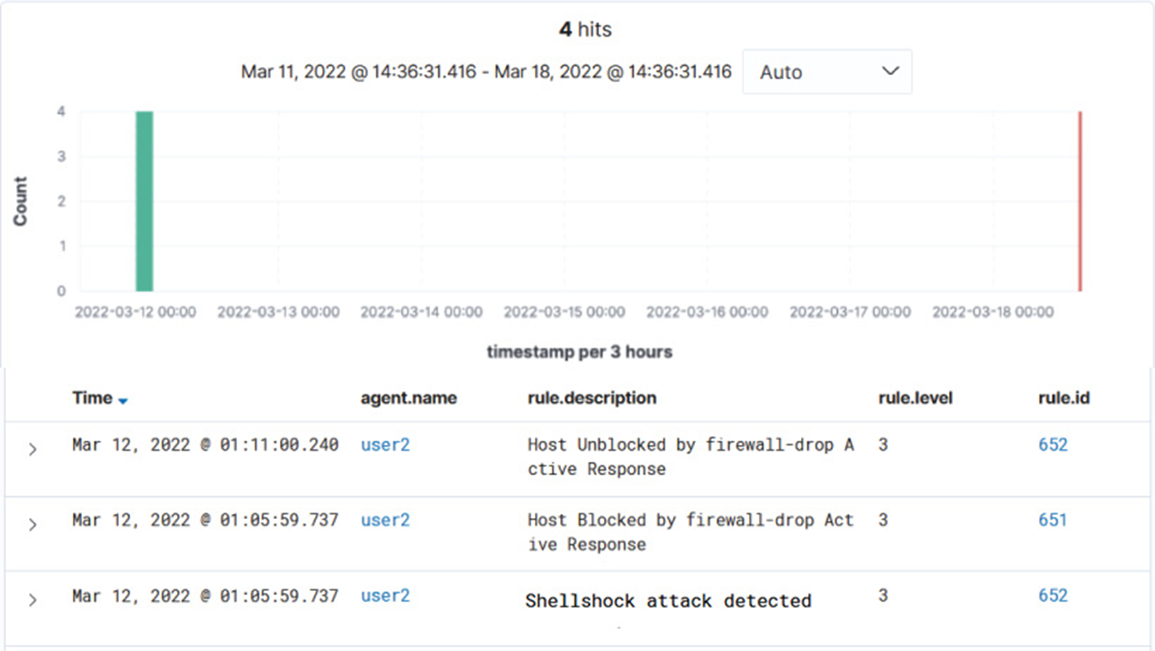
Capabilities
Globally Blacklisted IP
Hardware Inventory
Shell Shock Attack mitigation
Hardware Inventory
Global Blacklist Capabilities
Shell Shock

Slide 18
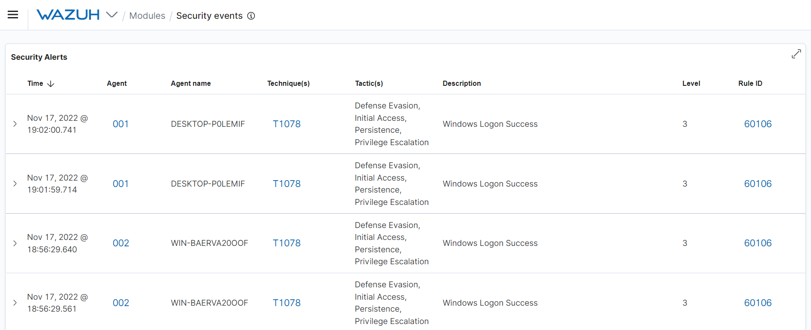
Capabilities
Security Event

Slide 19
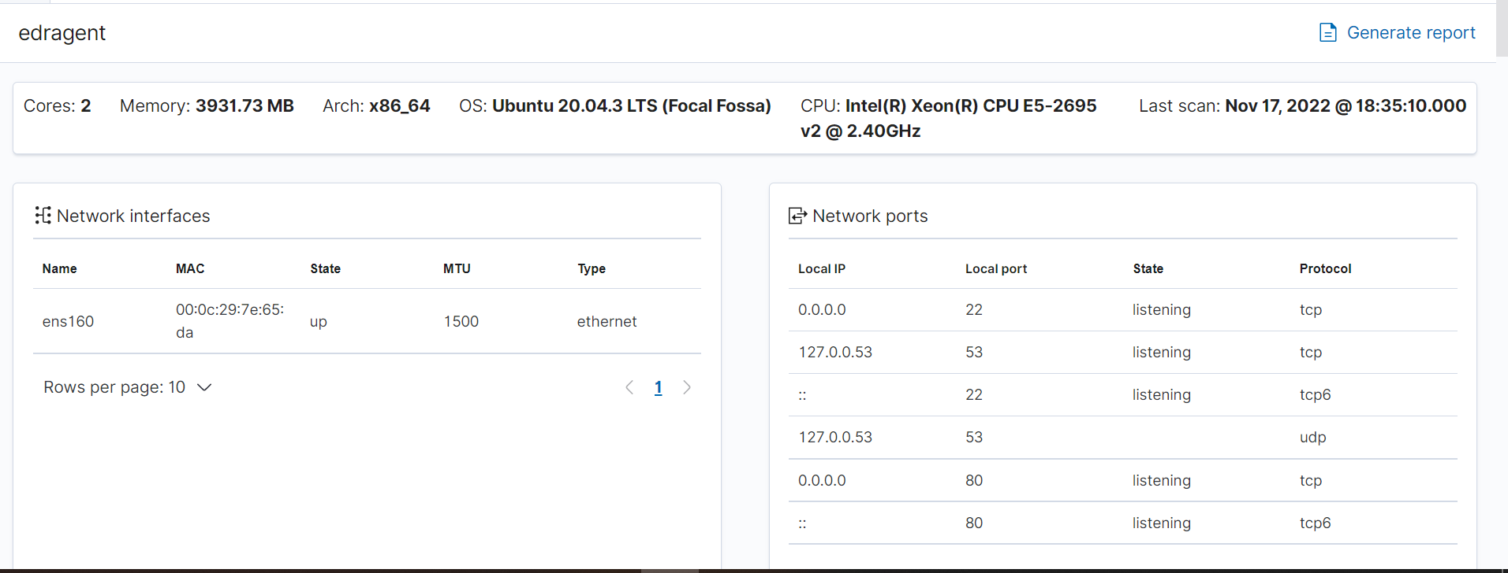
Capabilities
System Inventory

Slide 20





Future Expansion
Integrated with Firewall
Integrated with SIEM
Helping on Digital Forensics Operation
Increasing AR capabites

Slide 21

Limitation
Limitations
⮚All of the procedures and performance analyses were completed in a lab environment, nevertheless, there may be issues when executing in a practical setting.
⮚We are using a free subscription from Security Intelligent Cloud. That’s why it’s submitted a certain number of files.
⮚We collect global IP blacklist databases from single sources.
⮚We did get any technical support from OEM. We have to manage everything.

Slide 22
Conclusion
01
02
03
04
Conclusion
Conclusion
Conclusion
Conclusion
We have Deployed a Log based Endpoint Security Solution with some Open Source tools.
Integrated successfully with the third-party Security Intelligence. Such as VirusTotal Alienvault CVE database ect. And provide anti malware capabilities
Mitigated different types of cyber attacks.malware attacks, shellshock, brute force and attacks vulnerabilities detection, file integrity monitoring etc.
All the deployments we have done with minimal cost rather than an enterprise solution. Where to manage an enterprise solution needed 2200$ to 3500$ per month

Slide 23

Any Question

Slide 24

Reference
Annual Study on the State of Endpoint Security Risk https://www.morphisec.com/hubfs/2020%20State%20of%20Endpoint%20Security%20Final.pdf
Wazuh Documentation https://documentation.wazuh.com/current/deployment-options/elastic-stack/all-in-one-deployment/index.html
Elastic NV Documentation https://www.elastic.co/explore/security-without-limits/siem-buyers-guide?baymax=rtp&elektra=home&storm=sub1&rogue=eswt-771
Endpoint Architecture https://www.trellix.com/en-us/security-awareness/endpoint/what-is-endpoint-security.html
Log Based system https://help.eset.com/ees/9/en-US/idh_page_logs.html
Virustotal Intigration https://developers.virustotal.com/reference/overview
Aleint Valut integration https://mindflow.io/integration/integrate-with-alienvault/
Common Vulnerabilities Exposure Database https://cve.mitre.org/cgi-bin/cvekey.cgi?keyword=sql+injection
Ubuntu Repository https://packages.ubuntu.com/search?keywords=repo
RedHat Linux repository https://access.redhat.com/documentation/en-us/red_hat_enterprise_linux/6/html/deployment_guide/sec-configuring_yum_and_yum_repositories

Slide 25


